Slide 1
Interrobang
Merci Magallanes
Joey Martinez
John Hardy

Slide 2
Description
Players are confronted with three basic levels, which demonstrate the core mechanics of the game
Players control character with w,a,s,d, jump with spacebar, and sprint by holding shift
Players can die by touching spikes, teleporting them back to the beginning of each level
Players can activate buttons that have various effects within each level

Slide 3
Project Goals
Learn valuable skills in game design and programming for video games
Make a game that every member of the group was interested in, in the hopes that it would have a broader appeal to a wider audience
Create and finish a game idea that is both feasible, but engaging

Slide 4
Justification
We will be utilizing concepts learned in Interaction Design, Programming Languages, and game design
It will allow all group members to practice working within a group, and sticking to a schedule to collaboratively finish a full project
Some in the group will learn how to write code in C# for the first time. We will also implement our own user interface from scratch thus expanding on concepts we have learned.
If we feel that our project is moving along too easily, we could scale up the game by adding more content. We feel that the ideas we have already should be enough to keep us quite busy.
The scalability of the project allows it to fit within the time constraints of the semester.
We will have access to Unity and 3D modeling software for free through LMU.
fart

Slide 5
User Stories
Players often enter the game and are introduced to the first level as a sort of tutorial for how the game handles and how the controls feel
From this point the second level is used to increase the difficulty, and introduce spikes that can kill the player. In this case, most players encounter death for the first time, and the consequences that follow
The third level is introduced, that amps up the difficulty further, and makes for a formidable end to the MVP, allowing the player to utilize everything they have learned thus far in the game

Slide 6
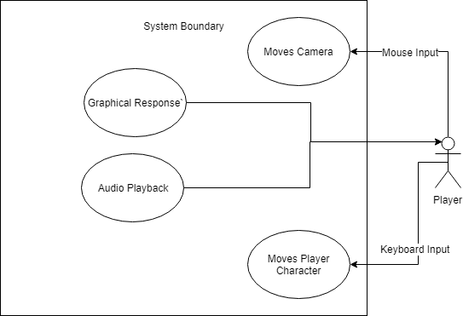
Use Case Diagram
Character offers input from mouse and keyboard to navigate and play the game
In response, the game offers various feedback to the players actions
The player then responds, and the cycle continues

Slide 7
User Interface

Slide 8
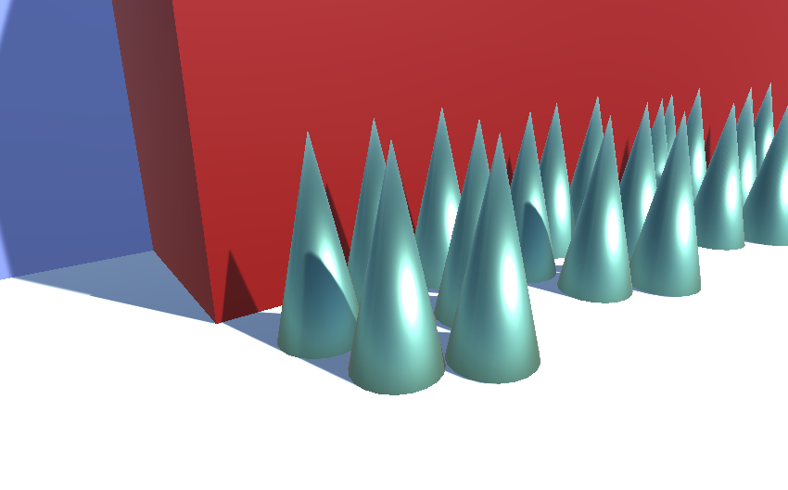
Spikes Functionality
When the player touches the spikes, they “die”

Slide 9
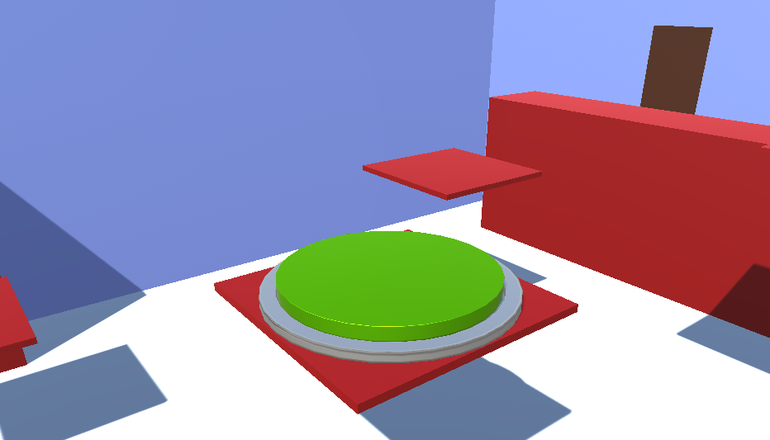
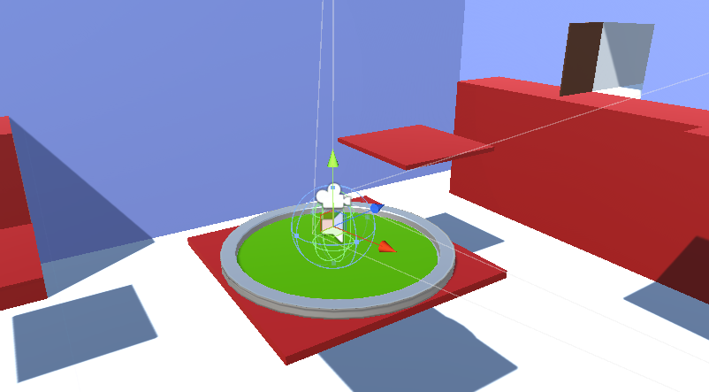
Button Functionality
The player opens the door by pressing the button

Slide 10
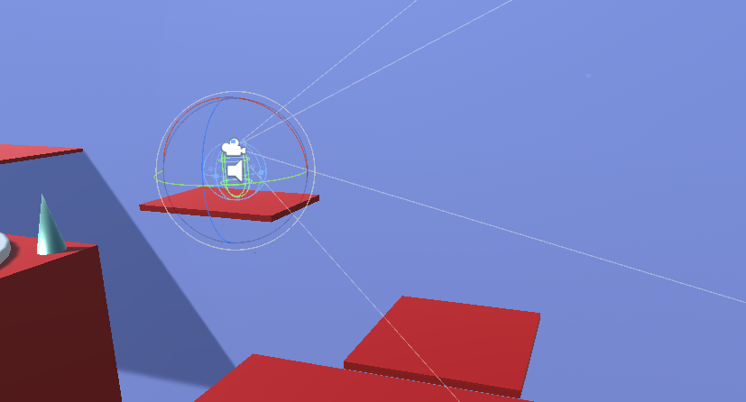
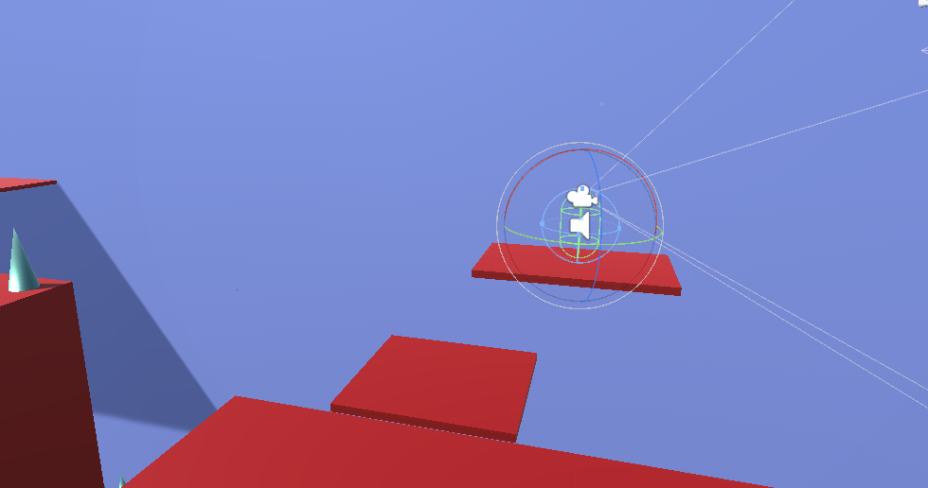
Moving Platform Functionality
The player sticks to the platform as it moves

Slide 11
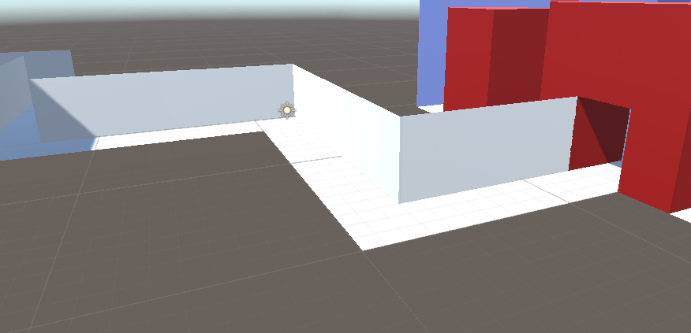
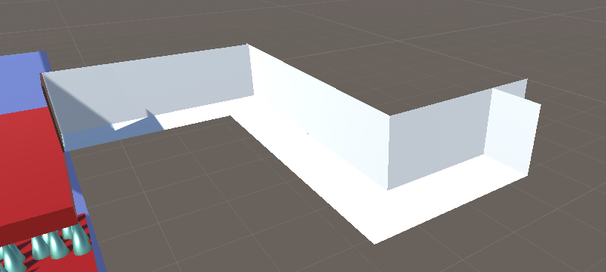
Looping Hallways Functionality
When the player passes a certain point in the final hallway, they are teleported back to the hallway that they started in

Slide 12
Demonstration
Basic functionality of player manipulation
Player interaction with the level
Understanding and completing each challenge in the levels
Finding the fastest path to reach the end
Fire up the game and see for yourselves!

Slide 13
Project Challenges
The greatest challenge we faced was source control. Our group wasted a lot of time just making sure that everyone had the same versions of the game. Merge conflicts also cause many problems for us.
Finding the inspiration to make original and interesting challenges for each level was difficult, especially since each level needed to get progressively harder.
Creating interesting visuals has also been a challenge since none of us have a lot of experience with making textures or meshes.
Writing the code that controls the flow of the game has also been a challenge.

Slide 14
Status Update
The Minimal Viable Product for our game is officially done.
The rest of the time developing Interrobang will not be spent create big new features, but rather fixing bugs and polishing the game.
We have had to downsize or remove some of the original plans that we had for the game in order to finish on schedule.

Slide 15
THANK YOU!
Questions?

